Slide 1
Real Estate Pricing EDA
Project 3
Submitted by –Ajit Kumar

Slide 2
Project Overview
This project aims to analyze and optimize residential property pricing by leveraging a diverse dataset. The focus is on understanding how various factors—such as location, property size, amenities, market trends, economic indicators, and historical data—affect house prices.
Key Objectives:
Identify Key Influencers: Determine the primary variables driving property prices.
Advanced Analytics: Utilize statistical methods, correlation tecchniques to uncover hidden patterns and insights
.
Data-Driven Insights: Create visualizations to represent relationships and trends within the data
Methodology:
Data Exploration: Analyze the dataset to understand correlations and relationships.
Visualization: Develop charts and graphs to illustrate key findings and support strategic decisions.

Slide 3
Tools and Frameworks used
Tool used- Python
Frameworks used- Pandas , Numpy , Matplotlib , Seaborn

Slide 4
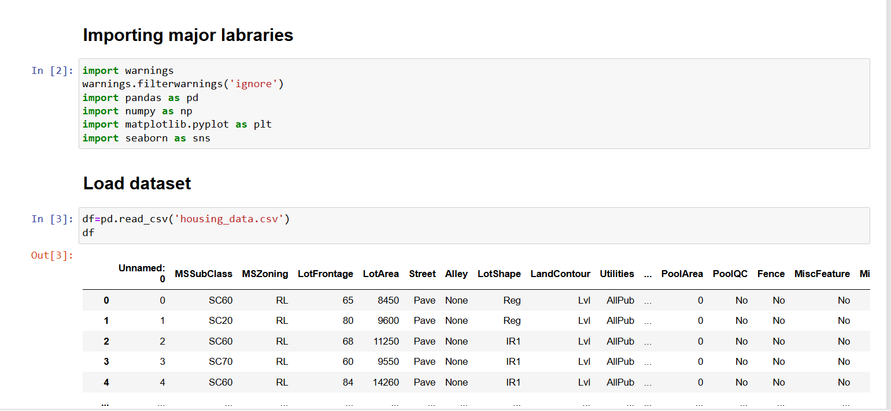
Importing data and major libraries

Slide 5
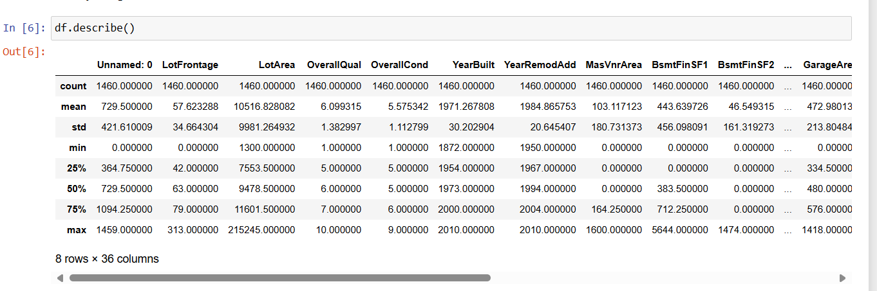
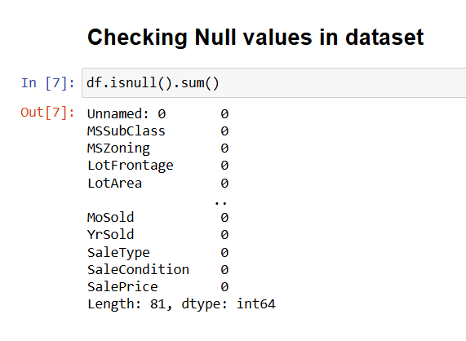
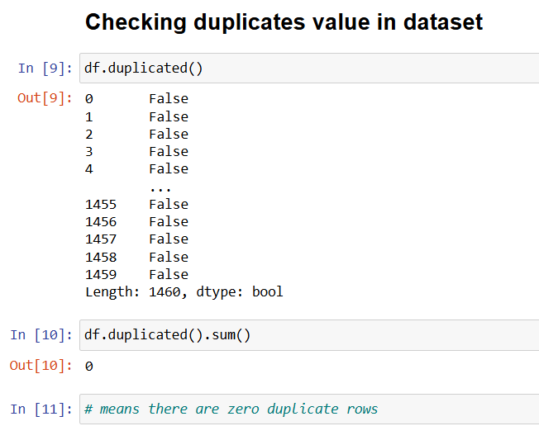
Checking data attributes
Checking data statistical info
Checking null values
Checking duplicates value

Slide 6
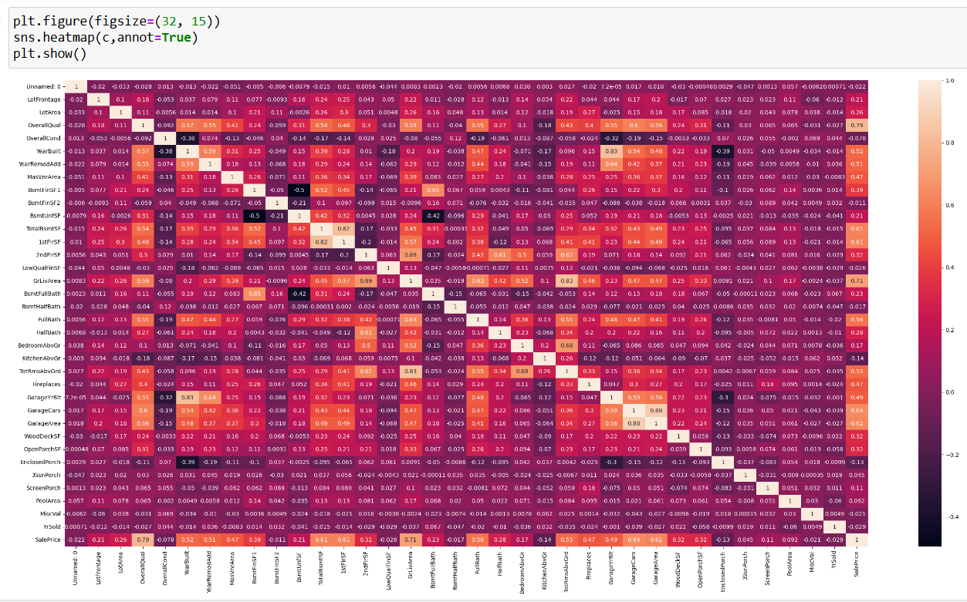
Heatmap to check correlation of other numerical variables with Sale Price
Numerical variables having correlation with Sale Prices with their score-
Lot Area-0.26
2. OverallQual-0.79 3. Year built-0.52
3.earRemmoAdd - 0.51
4.MassVnArea- 0.47
5. Bsmnt Fnish1-0.39
6. 1stFlrSF- 0.61
7.2ndFlrSF-0.32
8.GrLivarea-0.71
9.Full bath - 0.56
10.Halfbath- 0.28
11.TotalRms aboveGrnd- 0.53 12. Fireplaces- .47
13. GarageYsBlt=0.49
14. GarageCars=0.64 15. 15.Wood decks=0.32 16.OpenPorchSF=0.32
1.Score with >0.75 is considered as highly correlated
2. Score 0.5 to 0.75 are moderately correlated
3.Score <0.25 are less correlated

Slide 7
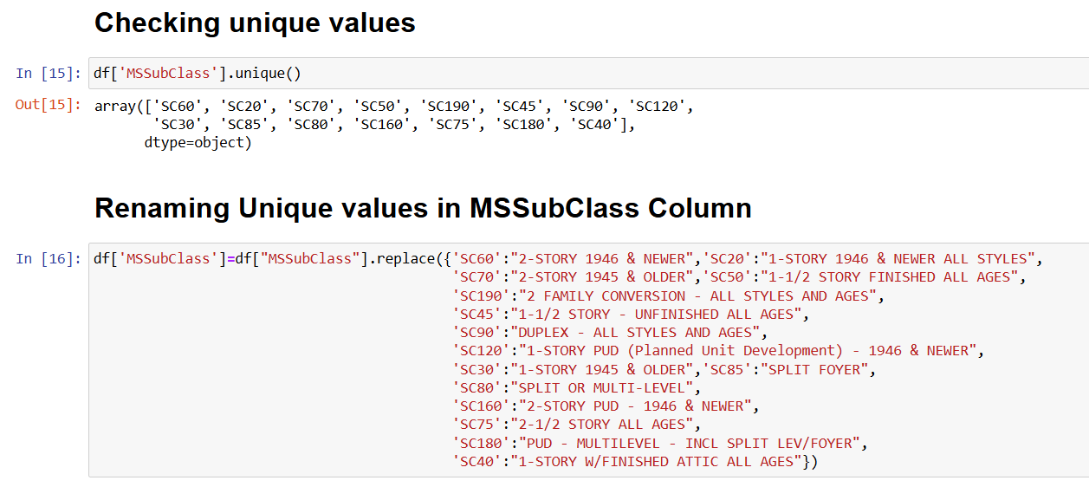
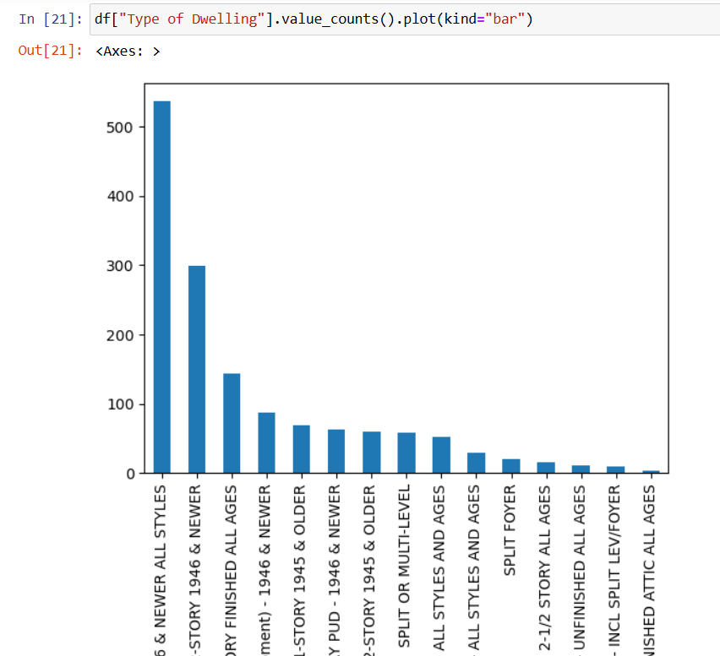
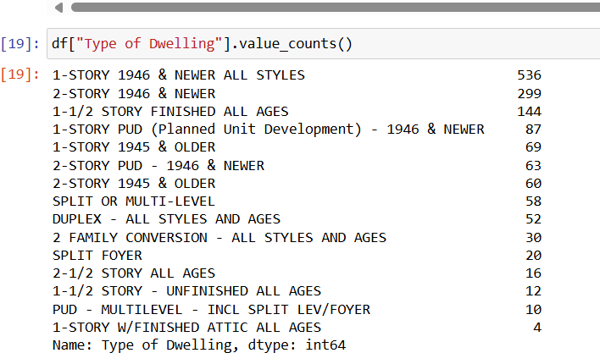
Renaming columns entries and attribututes examples

Slide 8
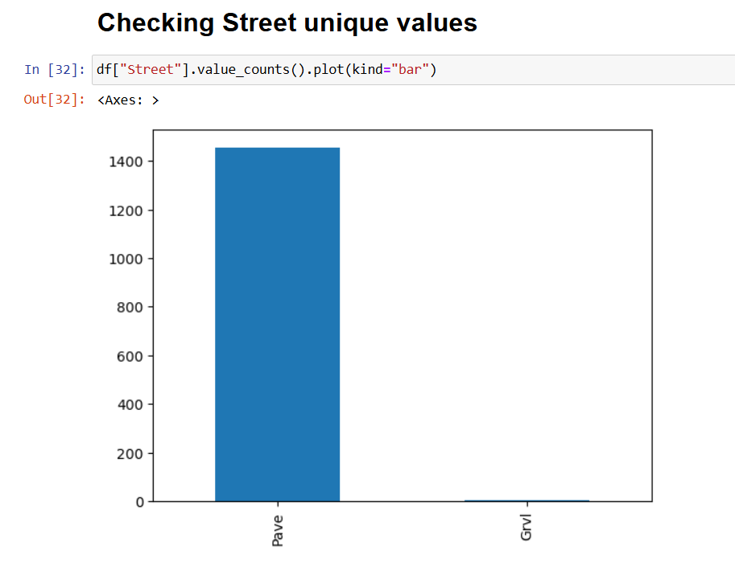
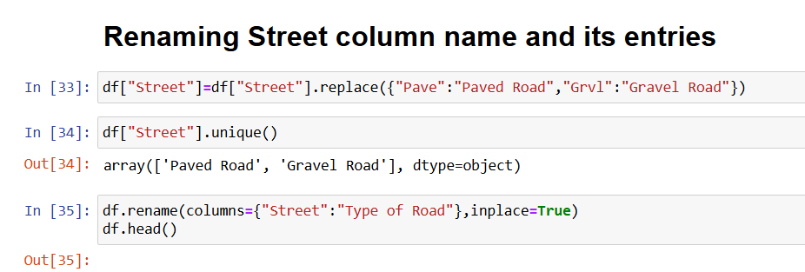
Renaming columns entries and attribututes examples

Slide 9
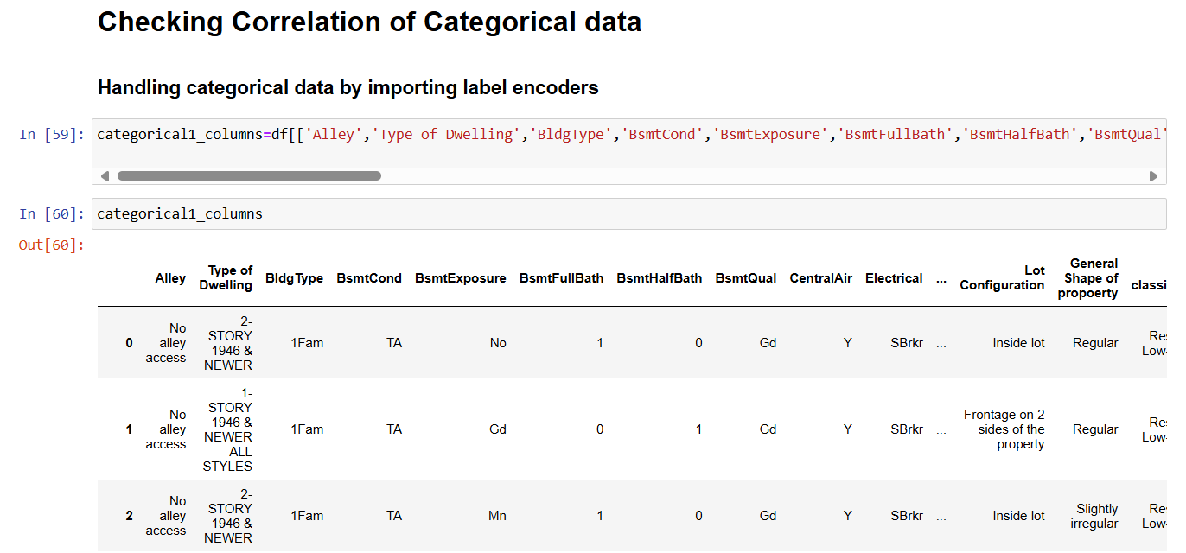
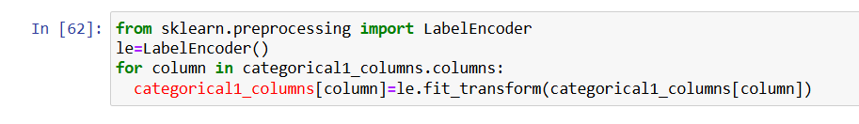
Handling categorical data
Importing label encoders for categorical data handling

Slide 10
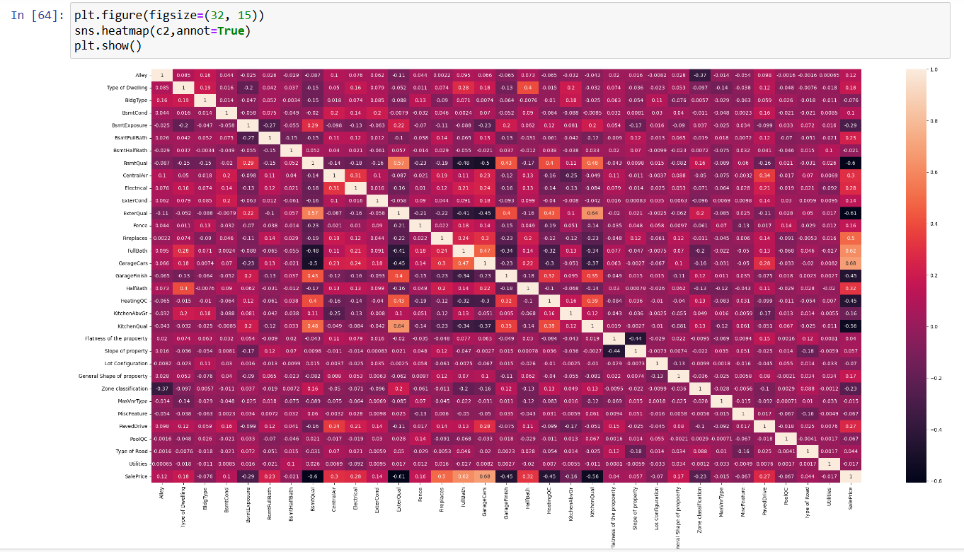
Checking correlation with Categorical data
Analysis-
1.Sales price has Moderate degree of correlation with 3 variables- Garage Cars, FullBath , Fireplaces
2.And low degree of correlation with 3 variables- Central Air, Electrical ,HalfBath , PavedDrive

Slide 11
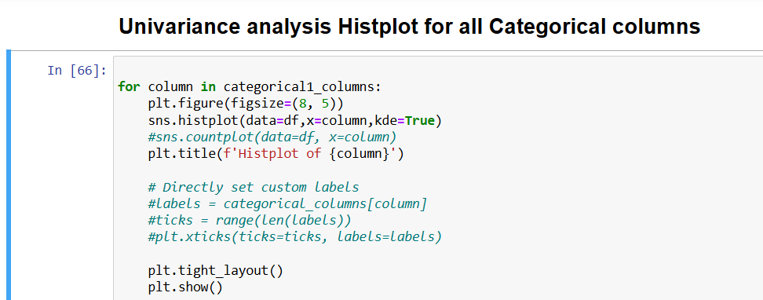
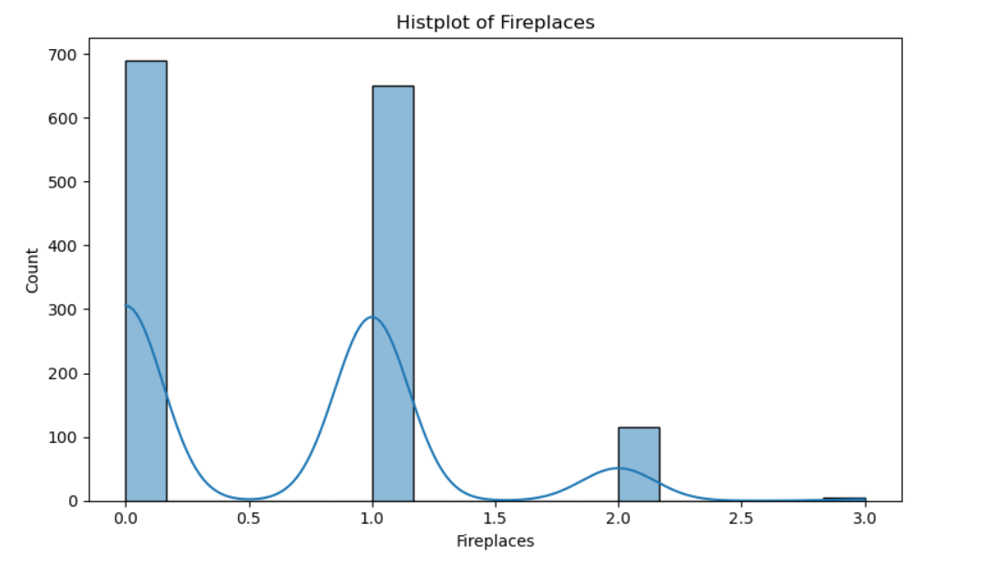
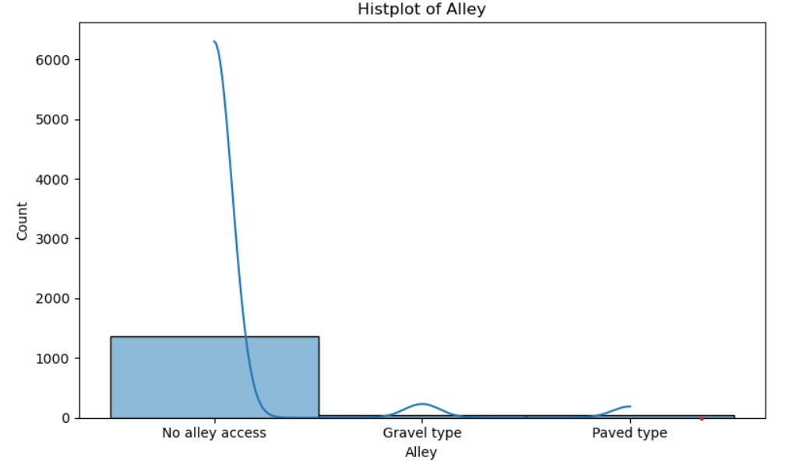
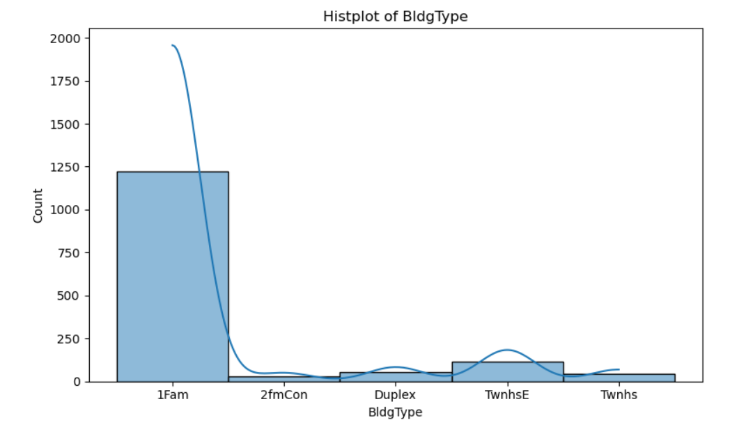
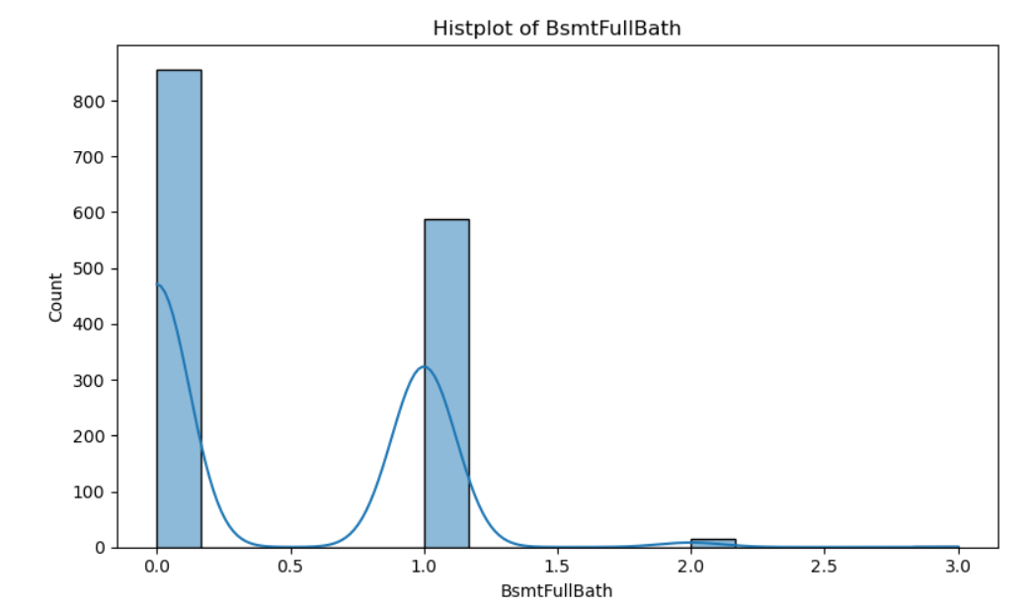
Univariance analysis of categorical data examples

Slide 12
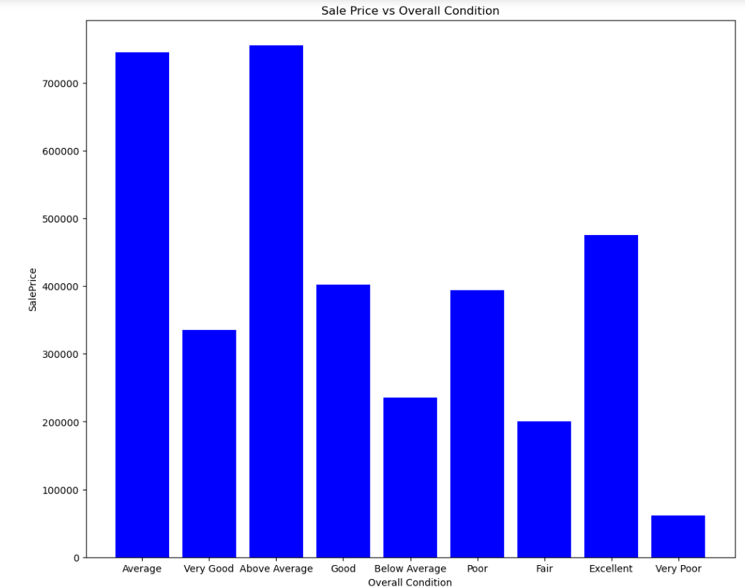
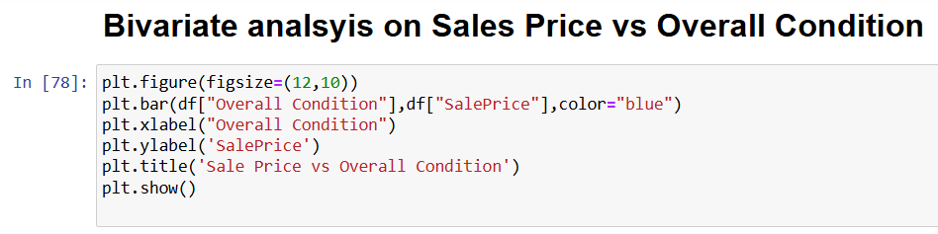

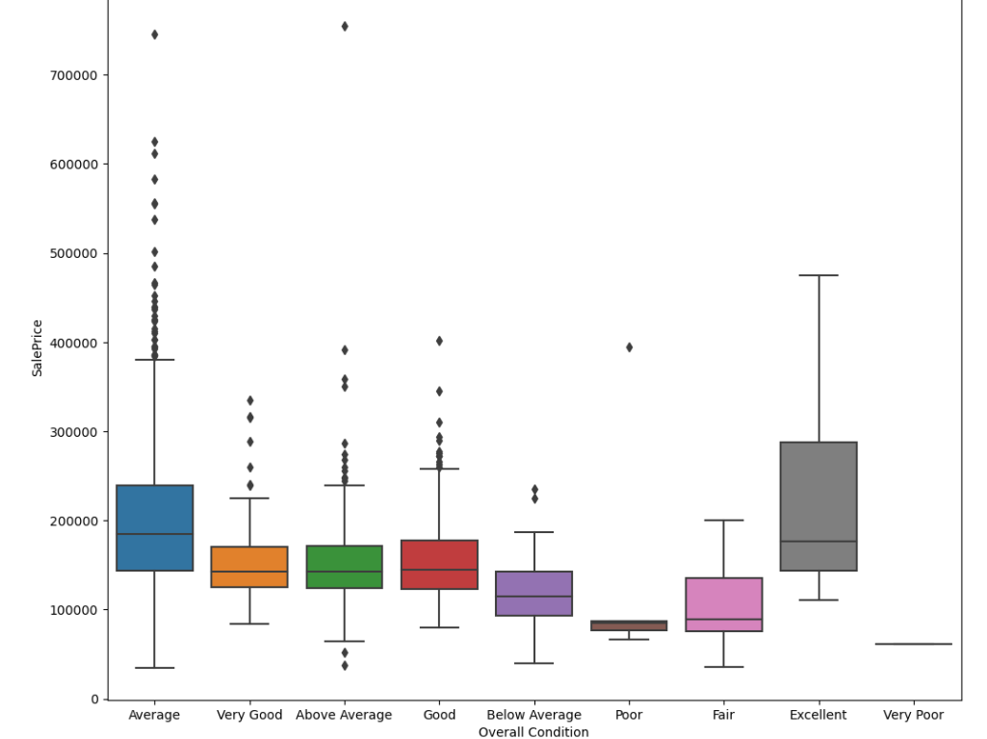
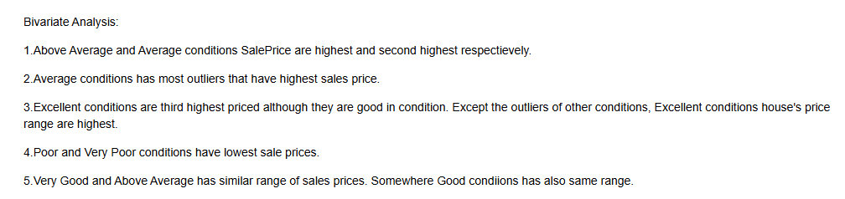
Bivariate analysis on Overall condition and Sales Price

Slide 13
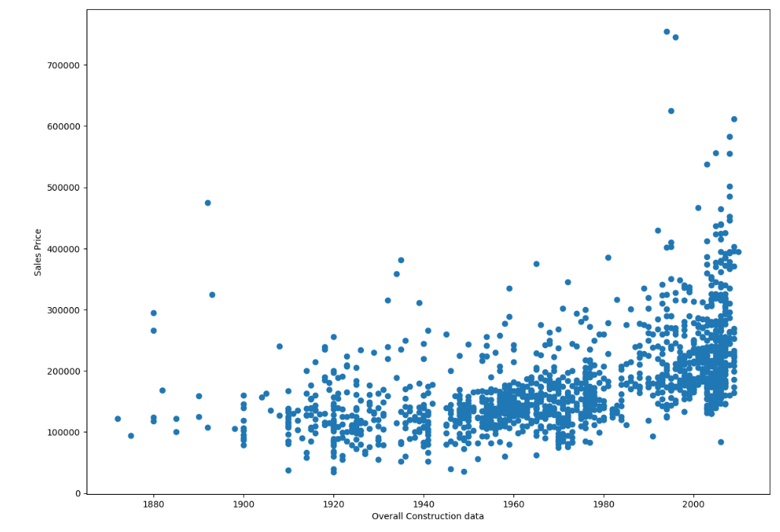
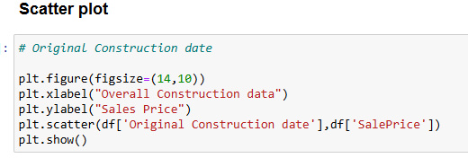
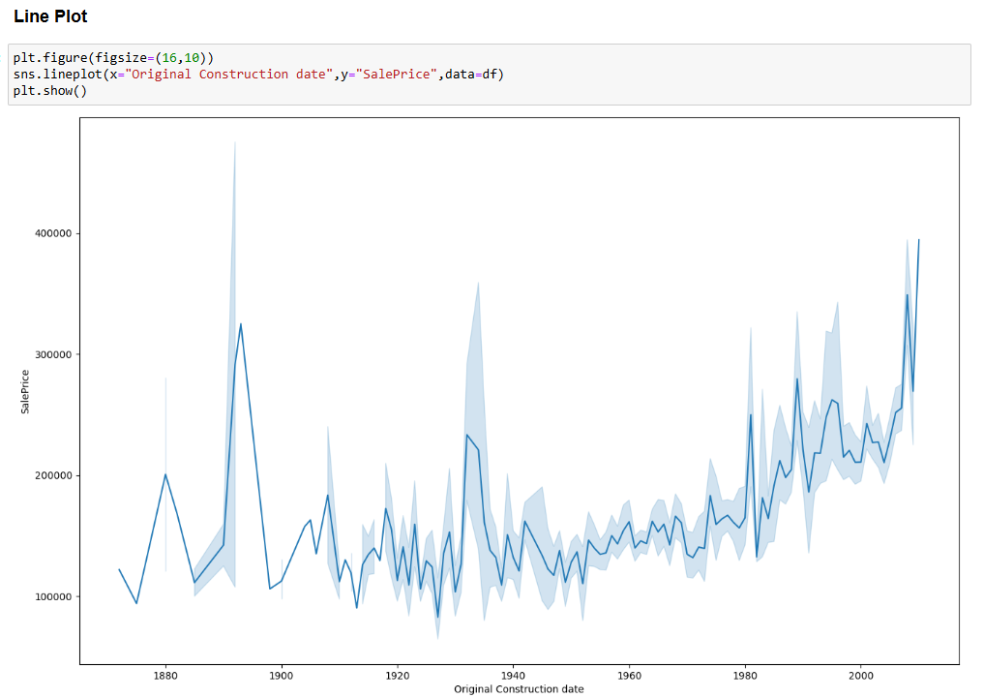
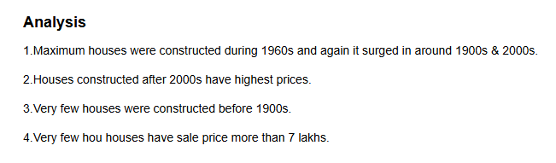
Bivariate analysis on Original Construction date and Sales Price

Slide 14
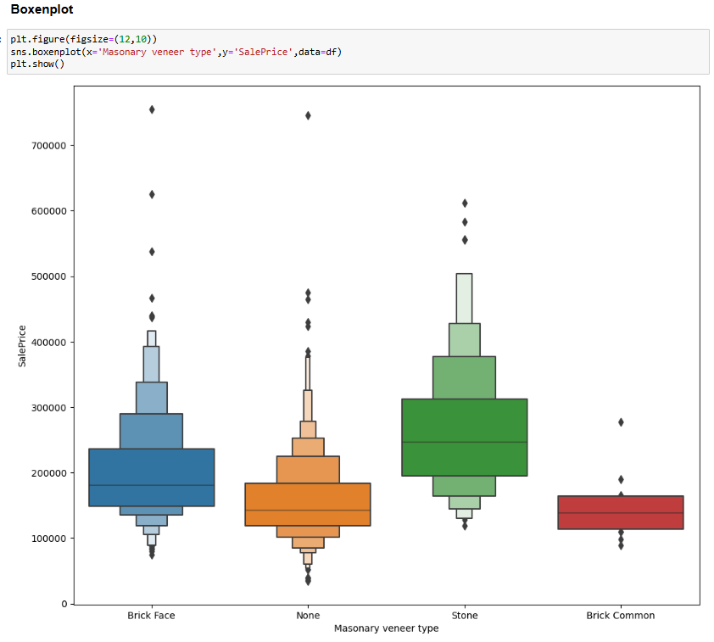
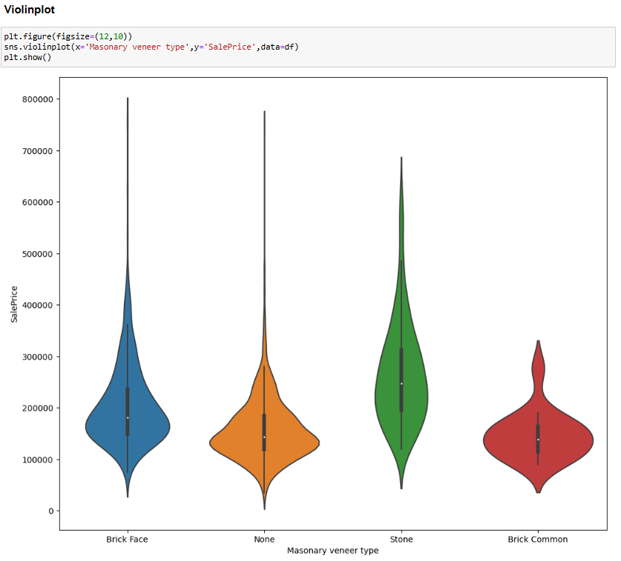
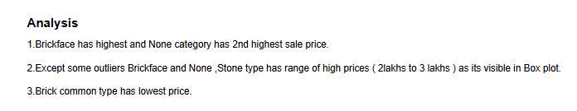
Bivariate analysis on Masonary veneer type and Sale Price

Slide 15
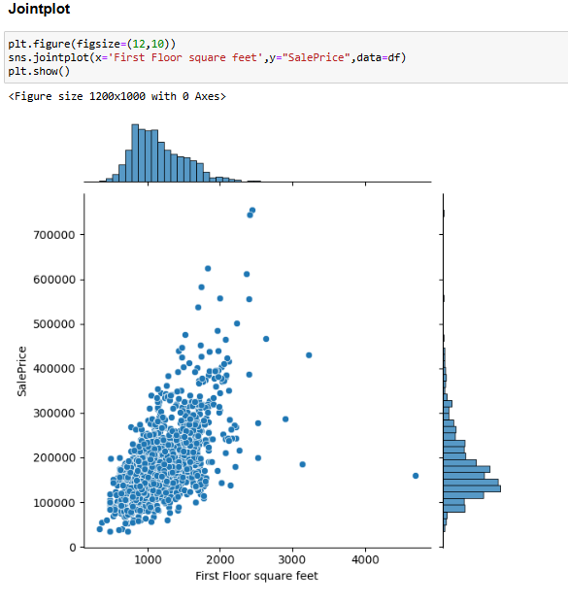
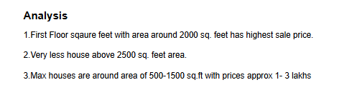
Bivariate analysis on First Floor square feet and Sale Price

Slide 16
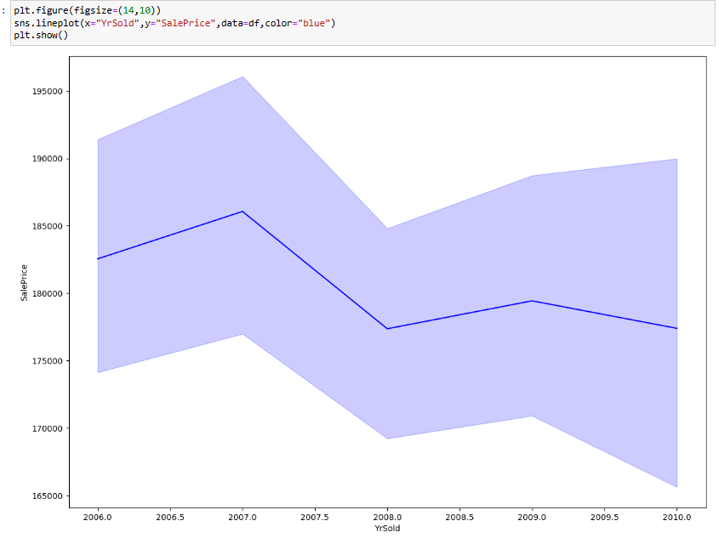
Bivariate analysis on Years Sold and Sale Price

Slide 17
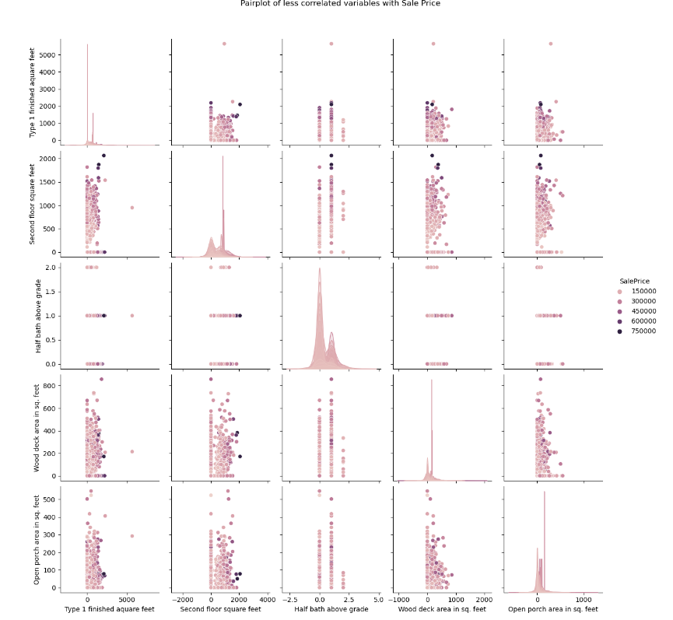
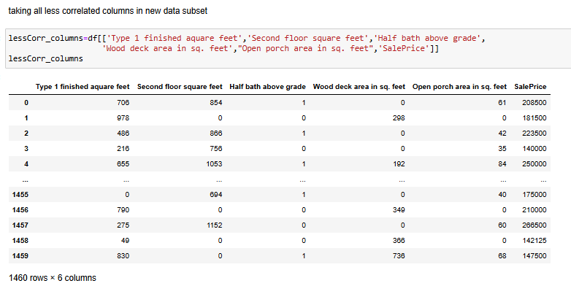
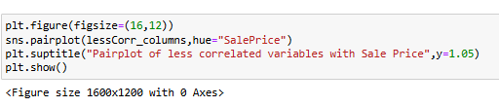
Pair Plot Multivariate analysis on less correlated data

Slide 18
THANK YOU !

